Slide 1
DEPARTMENT OF MATHEMATICS
SGGSJ GOVERNMENT COLLEGE
PAONTA SAHIB

Slide 2
COURSE NAME : VECTOR CALCULUS
COURSE CODE : 310TH

Slide 3
CONTENTS
Point function and its types.
Scalar and Vector point function .
Gradient of function.
Problem based on gradient of function.

Slide 4
POINT FUNCTION :
A Variable quantity whose value at any point in a region of space depends upon the position of the point , is called a point function.
Point functions are of two types:
1) Scalar point function.
2) vector point function.

Slide 5
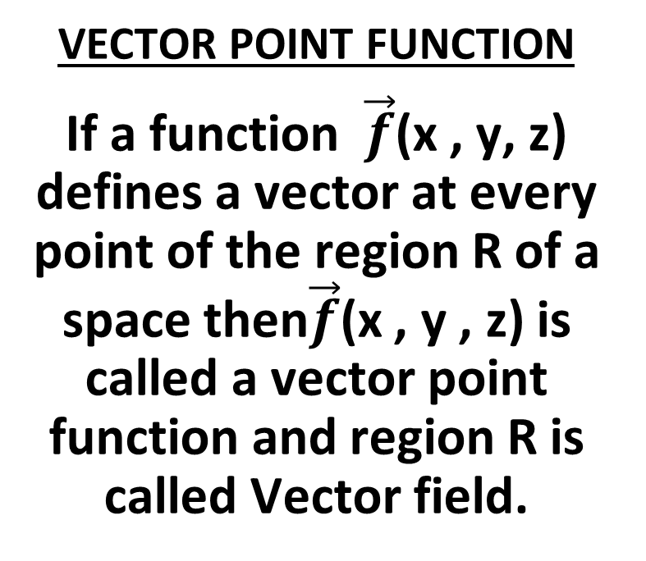
TYPES OF POINT FUNCTION
SCALAR POINT FUNCTION
A function f(x , y , z) is called a scalar point function if it associates a scalar with every point in region R of a space. Region R is called scalar field.
VECTOR POINT FUNCTION
If a function $\vec{f}$(x , y, z) defines a vector at every point of the region R of a space then$\vec{f}$(x , y , z) is called a vector point function and region R is called Vector field.

Slide 6
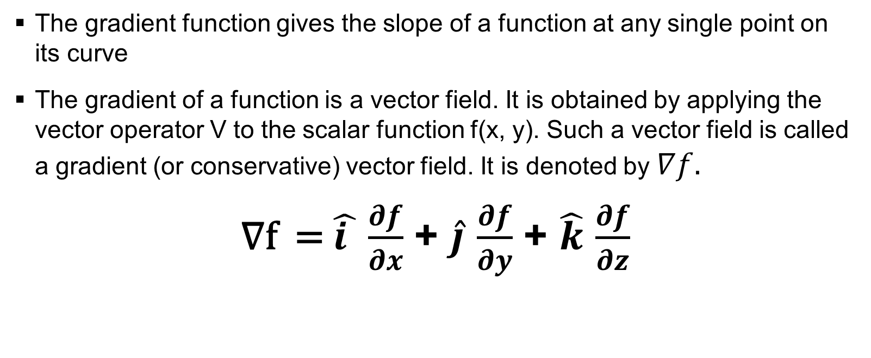
GRADIENT OF FUNCTION :
The gradient function gives the slope of a function at any single point on its curve
The gradient of a function is a vector field. It is obtained by applying the vector operator V to the scalar function f(x, y). Such a vector field is called a gradient (or conservative) vector field. It is denoted by $∇f.$
∇f = $\hat{i }$ $\frac{∂f}{∂x}$ + $\hat{j}$ $\frac{∂f}{∂y}$ + $\hat{k}$ $\frac{∂f}{∂z}$

Slide 7
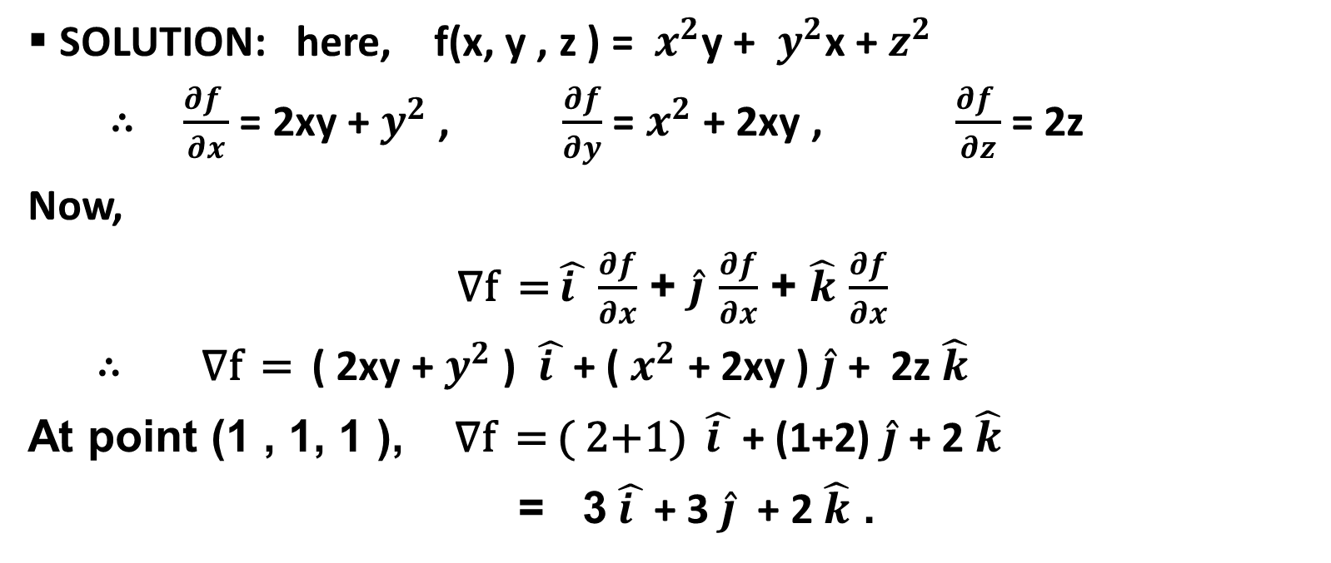

PROBLEM 1 : if f(x, y , z ) = $x^{2}y$ + $y^{2}$x + $z^{2}$. Find ∇f at the point ( 1 , 1 , 1 ).
SOLUTION: here, f(x, y , z ) = $x^{2}$y + $y^{2}$x + $z^{2}$
∴ $\frac{∂f }{∂x}$ = 2xy + $y^{2}$ , $\frac{∂f}{∂y}$ = $x^{2}$ + 2xy , $\frac{∂f }{∂z}$ = 2z
Now,
∇f = $\hat{i }$ $\frac{∂f}{∂x}$ + $\hat{j}$ $\frac{∂f}{∂x}$ + $\hat{k}$ $\frac{∂f}{∂x}$
∴ ∇f = ( 2xy + $y^{2}$ ) $\hat{i }$ + ( $x^{2}$ + 2xy ) $\hat{j}$ + 2z $\hat{k}$
At point (1 , 1, 1 ), ∇f = ( 2+1) $\hat{i }$ + (1+2) $\hat{j}$ + 2 $\hat{k}$
= 3 $\hat{i }$ + 3 $\hat{j}$ + 2 $\hat{k}$ .

Slide 8
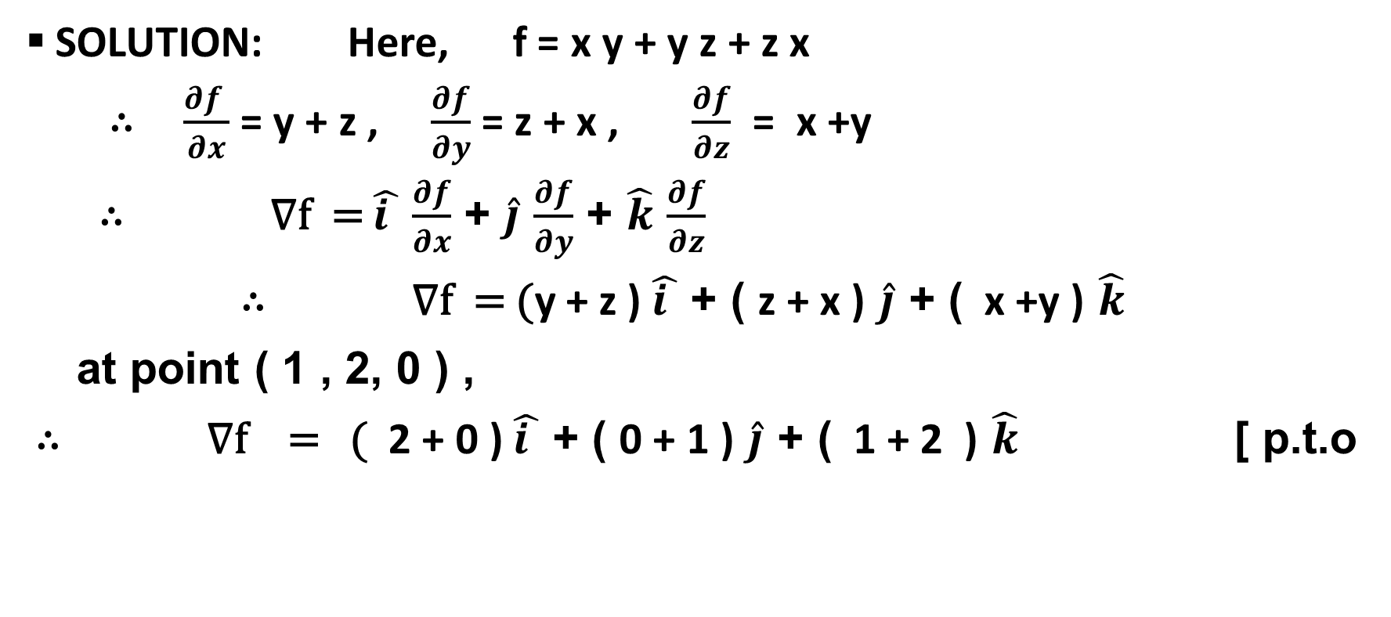

PROBLEM 2: Find the directional derivative of f = x y + y z + z x in the direction of vector $\hat{i}$ + 2$\hat{j}$ + 2$\hat{k}$ at the point ( 1, 2 , 0) .
SOLUTION: Here, f = x y + y z + z x
∴ $\frac{∂f }{∂x}$ = y + z , $\frac{∂f}{∂y}$ = z + x , $\frac{∂f}{∂z}$ = x +y
∴ ∇f = $\hat{i }$ $\frac{∂f}{∂x}$ + $\hat{j}$ $\frac{∂f}{∂y}$ + $\hat{k}$ $\frac{∂f}{∂z}$
∴ ∇f = (y + z ) $\hat{i }$ + ( z + x ) $\hat{j}$ + ( x +y ) $\hat{k}$
at point ( 1 , 2, 0 ) ,
∴ ∇f = ( 2 + 0 ) $\hat{i }$ + ( 0 + 1 ) $\hat{j}$ + ( 1 + 2 ) $\hat{k}$ [ p.t.o

Slide 9
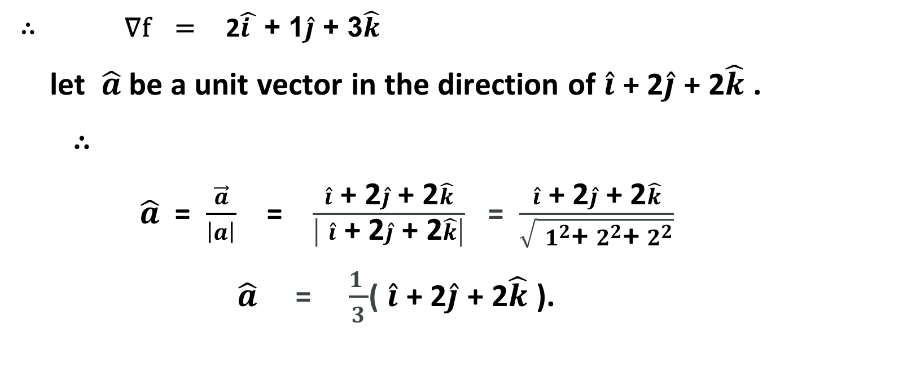
SOLUTIONS CONTINUES…
∴ ∇f = 2$\hat{i }$ + 1$\hat{j}$ + 3$\hat{k}$
let $\hat{a}$ be a unit vector in the direction of $\hat{i}$ + 2$\hat{j}$ + 2$\hat{k}$ .
∴
$\hat{a}$ = $\frac{\vec{a}}{\left|a\right|}$ = $\frac{\hat{i}\text{ + 2}\hat{j}\text{ + 2}\hat{k}}{\left| \hat{i}\text{ + 2}\hat{j}\text{ + 2}\hat{k}\right|}$ = $\frac{\hat{i}\text{ + 2}\hat{j}\text{ + 2}\hat{k}}{\sqrt{ 1^{2}\text{+ }2^{2}\text{+ }2^{2}}}$
$\hat{a}$ = $\frac{1 }{3}$( $\hat{i}$ + 2$\hat{j}$ + 2$\hat{k}$ ).

Slide 10
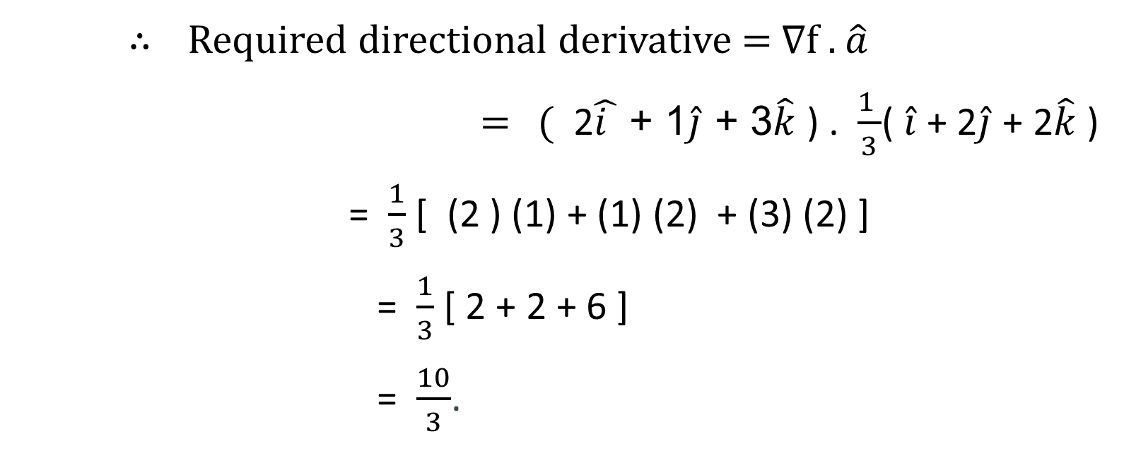
SOLUTION CONTINUES…
∴ Required directional derivative = ∇f . $\hat{a}$
= ( 2$\hat{i }$ + 1$\hat{j}$ + 3$\hat{k}$ ) . $\frac{1 }{3}$( $\hat{i}$ + 2$\hat{j}$ + 2$\hat{k}$ )
= $\frac{1}{3}$ [ (2 ) (1) + (1) (2) + (3) (2) ]
= $\frac{1}{3}$ [ 2 + 2 + 6 ]
= $\frac{10}{3}$.

Slide 11
THANKS FOR WATCHING…………..

